Slide 1
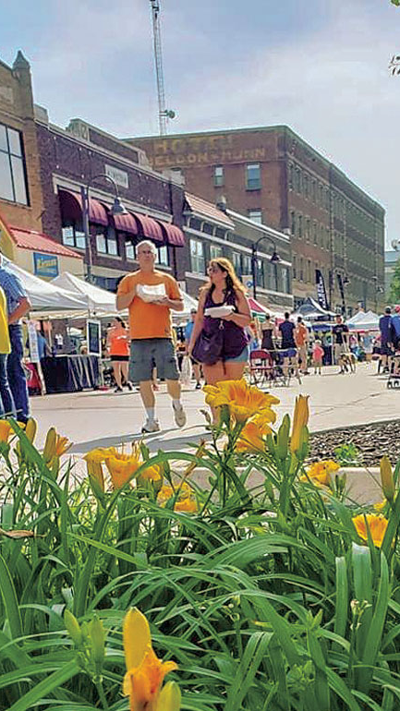


House Price Predictions Ames, IA
Little Deuce

Slide 2

Ames, IA
Location: Central Iowa
Population: 59K (2010 Census)
Median household income: 46132 USD
Poverty rate: 28.4%
Crime: below national & state averages
Landmarks:
Iowa State University (~28K)
Ames Laboratory (US DoE National Lab)
USDA’s Agricultural Research National Animal Disease Center (NADC)
2010: ranked 9th on CNN Money’s ‘Best Places to Live’

Slide 3

The Nitty Gritty…..
4 years of data (2006-2010)
80 feature variables
1460 sales @ 300 annually
180K average sale price with 2 car garage
38% of homes (551) are NMT 20 years old with 55% NMT 40 years
70% of sales (1015) have 2 - 4000 SF
Primary sales: Normal & conventional

Slide 4
Goals of Kaggle Competition

Slide 5
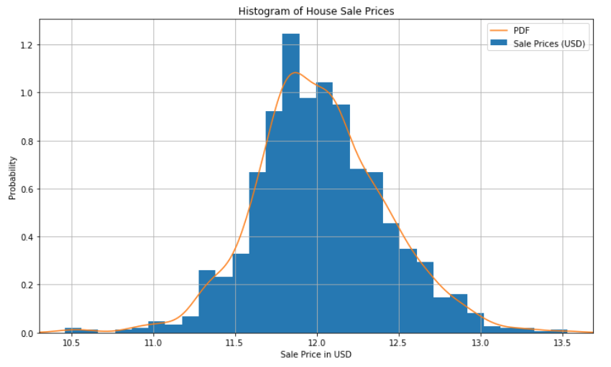
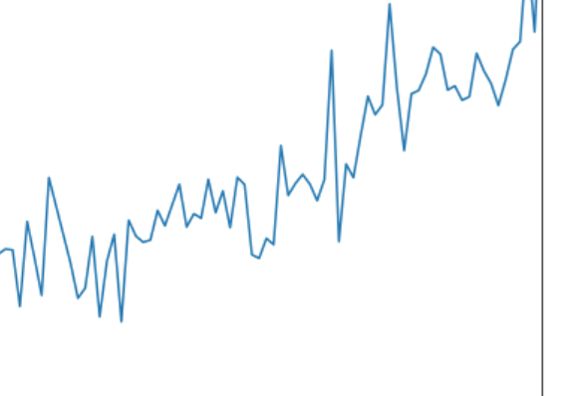
Sale Price Transformation
Log transformation
Root Mean Square Error (RMSE)
Time series depicts a steady, but not aggressive overall growth in the last 40 years

Slide 6

Exploratory Data Analysis
Year Built
Overall Quality
Total Square Footage (GrLivArea)
Garage Size – number of cars
Total Basement Square Footage
Lot Size

Slide 7

Excluded Variables
Neighborhood - Schools
Garage SF
Garage Condition
Heating
Central Air
Electrical
Kitchen Quality
Exterior Condition
Basement Quality
Basement Condition
Roof Material

Slide 8
Way Forward
Linear Regression Model
Initial Results:
Decision Tree/Random Forest
Expand Considered Variables
Categorize variables
Create ranked lists of non-numerical variables
Notes:
Year built with buckets
Heating Quality
Porch (Y/N variable only)
Proximity to desirable features

Slide 9

Extra Stuff

Slide 10
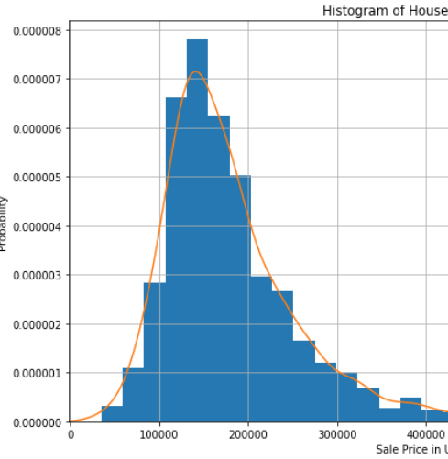
Sale Price Distribution
Mean: 180K ish
Median:
Mode:
Year built with buckets
Heating Quality
Porch (Y/N variable only)
Proximity to desirable features

Slide 11
Evaluation Metrics
Mean Square Error (MSE)
Average of the squared difference between the target value & predicted value
Easy to optimize & penalizes even small errors
Root Mean Square Error (RMSE)
Most common regression metric used
Useful when large errors are undesired – high penalty placed on large errors
Mean Absolute Error (MAE)
Robust to outliers & does not penalize as severely as MSE
Linear scoring where individual differences are weighted equally
Not suitable with attention is desired on outliers
R² Error
Compares current model with constant baseline model (mean of data)
Adjusted R²
Variant of R-squared

Slide 12
Home age:
38% NMT 20 years old (1990-2010) - 551
17% 20-40 years old(1970-1989) – 249
23% 40-60 years old (342)
22% (318) rest
Home size:
232: < 2000SF
553: 2000-3000 SF
462: 3000-4000 SF
213: > 4000 SF

Slide 13
Technical References
https://towardsdatascience.com/regression-an-explanation-of-regression-metrics-and-what-can-go-wrong-a39a9793d914
Pix:
https://financebuddha.com/blog/tax-benefits-owning-multiple-houses/
https://www.nuviewtrust.com/self-directed-regulation-d-real-estate-fund-investments/
https://bks-partners.com/insights/capture/

Slide 14
0…………………..
https://www.census.gov/quickfacts/fact/table/amescityiowa/INC110218
https://www.census.gov/quickfacts/fact/table/amescityiowa/INC110218
https://data.bls.gov/timeseries/LASST190000000000005?amp%253bdata_tool=XGtable&output_view=data&include_graphs=true
https://www.areavibes.com/ames-ia/crime/

